Slide 1
Title goes here
Subtitle goes here

Slide 2
Alternative Title Page
Subtitle goes here

Slide 3

Agenda
First item is bullet one
Second item is bullet two
Next agenda item is bullet three
Fourth agenda item
Add another agenda item here
Bullet with longer and final agenda item

Slide 4

8x8 Mission
Reinvent business communications with the power of the cloud to deliver one continuous experience that changes the way companies communicate globally.

Slide 5

Slide Title Goes Here
Bullets are in sentence case
  This sample has the footer text removed
    Image bleeds off the bottom
      Fourth, and so on and so on
        Fifth item listed for the audience to view

Slide 6
Example of Category Sections
Category or bullet text would stack inside this area
Category or bullet text would stack inside this area
Category or bullet text would stack inside this area
Category
Category or bullet text would stack inside this area
Category or bullet text would stack inside this area
Category or bullet text would stack inside this area
Category
Category or bullet text would stack inside this area
Category or bullet text would stack inside this area
Category or bullet text would stack inside this area
Category

Slide 7

One Column with Image Background
Bullets are in sentence case
  Second bullet listed here
    Third item listed
      Fourth, and so on and so on
        Fifth item listed for the audience to view

Slide 8

One Column with Image Background
Bullets are in sentence case
  Second bullet listed here
    Third item listed
      Fourth, and so on and so on
        Fifth item listed for the audience to view
Use a bar to summarize the key point your slide is making.

Slide 9
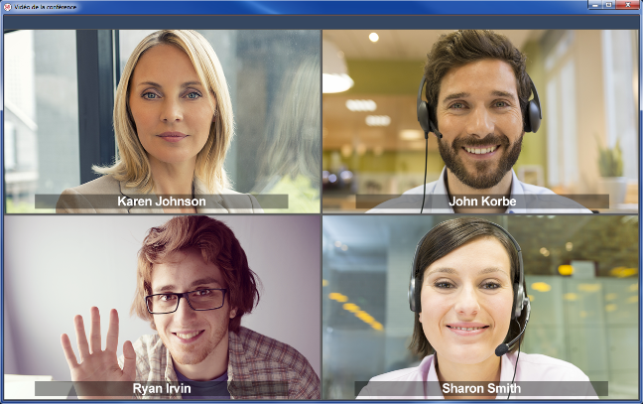

Example of an Image Slide
Image label would appear underneath and centered

Slide 10


Example of Image Slide

Slide 11

Example of Product Image

Slide 12
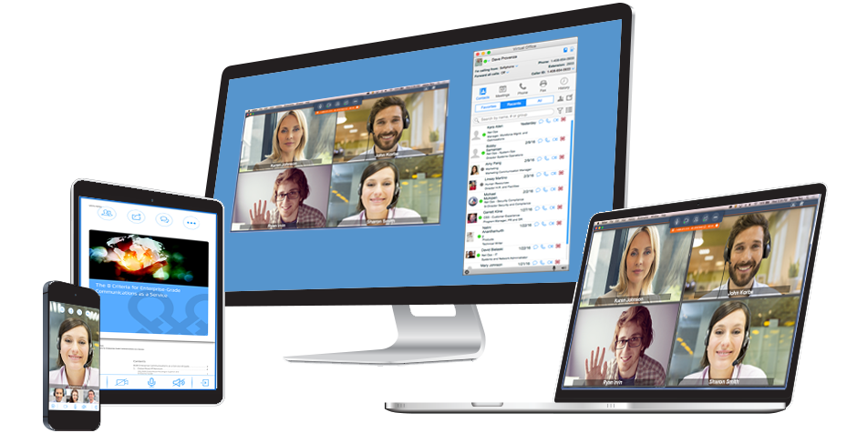
Example of Product Image

Slide 13

Graphic with Image Background
Global
One
Platform
Enterprise Grade
Intuitive User Experience
Mid-Market
& Enterprise Growth

Slide 14
Table Chart Example
 | Example 1 | Example 2 | Increase
Item One | 100,000 | 150,000 | 50%
Item Two | 100,000 | 150,000 | 50%
% of Item Two | 100% | 100%
Item Three | 100,000 | 150,000 | 50%
% of Item Three | 100% | 100%
Item Four | 100,000 | 150,000 | 50%
% of Item Four | 100% | 100%
Item Five | 100,000 | 150,000 | 50%
% of Item Five | 100% | 100%
Item Six | 100,000 | 150,000 | 50%
% of Item Six | 100% | 100%

Slide 15




Multi-Column Comparison Chart Example
Customer Name | Lines & Seats | Global Locations | Won Against | Channel Partner | Why They Chose 8x8
 | VO: 9,700 VCC: 105 | Corporate HQ & offices 4,100 US stores Upcoming: International stores | AT&T RNG Fuze | Simplify | Global presence Full featured integrated CC Creative retail service package VO Analytics
 | VO: 581 VCC: 305 WFM: 405 | Sydney, Australia Portland, Maine Munich, Germany | Fuze/ InContact | Direct | Gartner MQ leader Single vendor with one platform across UC & CC Global presence Security & Compliance
 | VO: 26,500 VCC: 200 | Current deployment in US & UK Soon expanding to 500 additional global locations | Fuze, ININ | Direct | Gartner Magic Quadrant Leader Global presence VCC Global Ease of implementation

Slide 16
Sample Diagram
Customer Acquisition
Marketing
Brand Awareness
Demand Generation
Sales Enablement & Customer Adoption
Direct and Indirect Channels
Customer
Service &
Support
Onboarding
User adoption
Lifecycle experience

Slide 17
Example of a Doughnut Chart
22%
60%

Slide 18
Example of a Bar Chart

Slide 19
Example of 2 Charts Side by Side
Comparison 1
Comparison 2

Slide 20




Graphic Treatment Example
Conferencing
Contact Center
Line of Business
Analytics
Voice & UC
HD Audio
WiFi/4G Continuity
Hot Desk
Barge-Monitor-Whisper
Mobile UX
VO Meetings
HD Video
Global Collaboration
Mobility
Expert Connect (UC/CC)
Multi-Chat
Quality Mgmt
CoBrowse
Global CC
EasyContactNow
Enhanced VO Call Analytics
VCC Analytics / Dashboards
One Platform: Security, Reliability, Single Sign-On (SSO), Global Expansion

Slide 21
















Example of Chart and Highlight Banner
Sample Customers
Sample Partners
Key point of slide goes here

Slide 22



Boxed Text Example
Product Portfolio
Enterprise Grade
Tools for Global Delivery & Scale
HD Audio and Video
Hot Desk & Barge-
Monitor-Whisper
Quality Management
Co-Browse
EasyContactNow
PBX Scale (10k+ seats) & Clustering
End-to-End Call Quality SLA
Big Data & Predictive Analytics
Global Corporate Directory
Microsoft S4B Integration
Automated Network Assessment
Bulk User Configuration
Number Management
Carrier Monitoring & Assessment

Slide 23




Split Layout Example
Item One
This is an example of a bullet that is longer and wraps to two lines
This bullet is also longer and wraps to two lines
This is an example of a bullet
A bullet example
Item Two
This is an example of a bullet that is longer and wraps to several lines
A bullet example
This bullet is also longer and wraps to two lines
Item Three
This is an example of a bullet that is longer and wraps to two lines
This is an example of a bullet
Item Four
This is an example of a bullet that is longer and wraps to two lines
This bullet is also longer and wraps to two lines

Slide 24
Section Divider Sample

Slide 25
Section Divider Sample

Slide 26
Section Divider Sample

Slide 27
Section Divider Sample

Slide 28
Thank You

Slide 29
Connect with 8x8
For tips, updates and the latest information
8x8.com
@8x8
facebook.com/8x8Inc
linkedin.com/company/8x8
youtube.com/8x8Inc

Slide 31

The Washed Image Treatment
Place your image on a blank slide and then select it.
In the menu, go to:
Format Picture > Recolor and select Accent 3 Light
For a faded image technique (where left side is more faded
than the right so text shows better)
Copy the rectangle from the image at right
then place it over your image & resize
OR
Draw a white rectangle on top of your image
Select it, then right click and select Format Shape.
Line = No Line, Shadow = No Shadow
Then select Fill > Gradient, Style = Linear
For the Color and Transparency, select the right slider adjuster and change its transparency to 65%
Then capture the image as a screen grab, save and use as background image
original
Recolored image
With faded rectangle on top

