Slide 1
8x8 Corporate Overview
Third Quarter Fiscal 2017

Slide 2


The Global Leader in Cloud Communications
Business Customers
Global Employees
47k +
1k +
5-Time Leader
25 Consecutive
Profitable Quarters
Leveraging the power of the cloud for global real-time communications and actionable analytics to enhance business productivity and performance.
Notes:
Purpose of slide: Establish credibility as a respectable company, leader in our industry, and stability as partner with prospect going forward.
₋₋₋₋₋₋₋₋₋₋₋₋₋₋₋₋₋₋₋₋₋₋₋₋₋₋₋
Good thing is we can help you with all of these challenges…and we’ve been able to do this for over 47k business customers…which we support with a global workforce of over 1k employees that operates across multiple continents…and we’ve been doing this for years which is why we’ve been recognized by Gartner as a 5 time back to back leader.
We’re also publically traded with a long history of financial stability…this has allowed us to invest heavily into our R&D to provide a single global solution that’s our own platform and not 3rd party offerings that we’re reselling.
Now, I wanted to highlight just a few of the companies we support…

Slide 3

Strategic Forces Disrupting IT
Globalization
Businesses are facing new competition from all regions of the world.
Distributed Workforce and Mobility
People expect to be able to work anywhere.
Personalized Customer Experience
Businesses must personalize every aspect of their customer journeys.
Notes:
The ability to communicate is the lifeline of any business. But the world is changing. Customers demand faster, better, anytime and anywhere service from you. Your employees need the tools to do this.
Three major forces are actively disrupting IT in the enterprise, impacting how decision-makers should consider how effectively they are enabling the business to deliver on successful communications to drive profitable growth
Globalization - Globalization is unstoppable. Businesses that provide products and services from almost any industry are facing new competition from all regions of the world. And once regional businesses are spreading their reach and operations to all parts of the world.
Distributed Workforce and Mobility – Work used to be a place, but people expect to be able to work anywhere. When traveling, with customers or at a remote office, the expectation is that your office comes with you.
Personalized Customer Experience – The internet of Me – Everybody has their own Internet experience, customized to serve their own individual interests, location, current activities, based on crumbs we each leave behind in our web journeys. Customers expect a more personalized experience in every aspect of their customer journey. That puts pressure on the enterprise to make sure they are actively personalizing their own customers’ journeys. Think it about what it will take to enable your customer-facing associates to deliver on personalized customer experience.
These are transformations led by cloud companies – picture what Uber did to the taxi, or one-off ride industry; or HomeAway for the travel industry, or Zappos to the retail shoes industry, or Salesforce.com to the CRM industry. What’s around the corner in your industry?
Now if you look at these trends, with an analytic mind, and then picture your legacy communications or PBX in relation to these trends, well, you realize you’ve got a big problem on your hands.

Slide 4








The Way the Workforce Communicates Is Changing
Desk Worker
Flex Worker
Remote Worker
The Problem: On-Premises Technology is Outdated
Limited multi-device support
Complex administration
Multi-location difficulty
Expensive
hidden costs
Disparate
systems
Notes:
Now, one of the challenges we’ve been able to help many of our customers with is the changing workforce and specifically how the way we communicate is changing…we’re all familiar with the desk worker and the concept of having your business phone on your desk while working on a computer (and our solution that I’ll walk you through just a bit can handle this and supports this well) …but part of the challenge now is keeping those individuals connected as they roam around the office, sit in meetings, step out for lunch, or work remote.
The problem with on-premises solutions is that they quickly become outdated and they don’t support these changes well.
One of the biggest concerns is a lack of strong multi-device support…the concern here is that we find many employees using personal devices for business purposes (share company image issue, or data leakage, or lost customers)
Go through rest of list as appropriate…

Slide 5


The Power of the Cloud
Real-time Analytics and Reporting
Agility and Flexibility
Mobile and Global
Business Continuity
Quick to Deploy
Cloud
Communications
Easy to Use
and Manage
Lower TCO
5

Slide 6




Cloud Communications Adoption by Larger Businesses Accelerating
Small Business
(1-99 emp)
~ 30% of employee endpoints in small business
Medium Business
(100-999 emp)
~20% of employee endpoints in med business
Large Business
(1,000+ emp)
~50% of employee endpoints in large business
UCaaS share: ~22-25%
(é~20%)
UCaaS share: ~12-15%
(é~25%)
UCaaS share: ~5%
(é~45%)
Source: Gartner, June 2015
Notes:
Small businesses were first to adopt - primarily for cost savings
Now, the mid-market and enterprise segments are coming on board not only to achieve cost savings but to also reduce complexity, IT management resources, enhance productivity, agility, speed to deployment, mobility, collaboration, customer engagement and more
Gartner predicts adoption by these larger business market segments will grow fastest
8x8 is seeing that momentum reflected in our growth

Slide 7



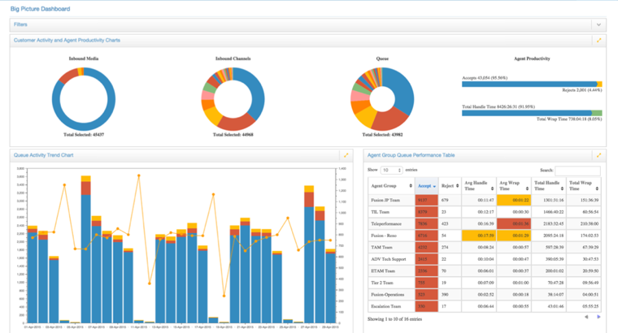
8x8: Enterprise Communications as a Service (ECaaS)
VOICE & UNIFIED COMMS
CONFERENCING
CONTACT CENTER
ANALYTICS
Integrated Suite Over a Single Common Platform
Secure, Reliable, Global. 100% Cloud.

Slide 8
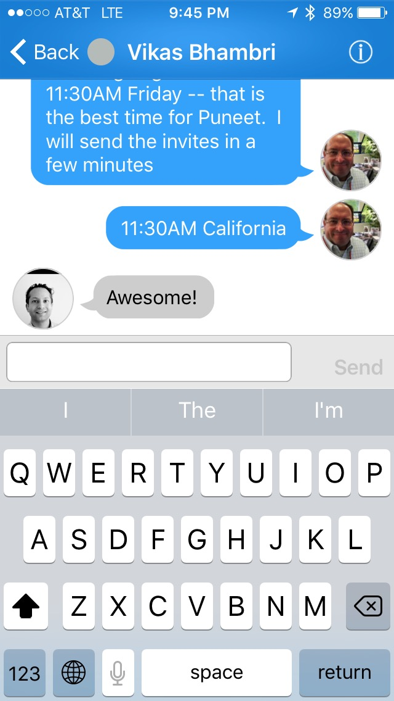
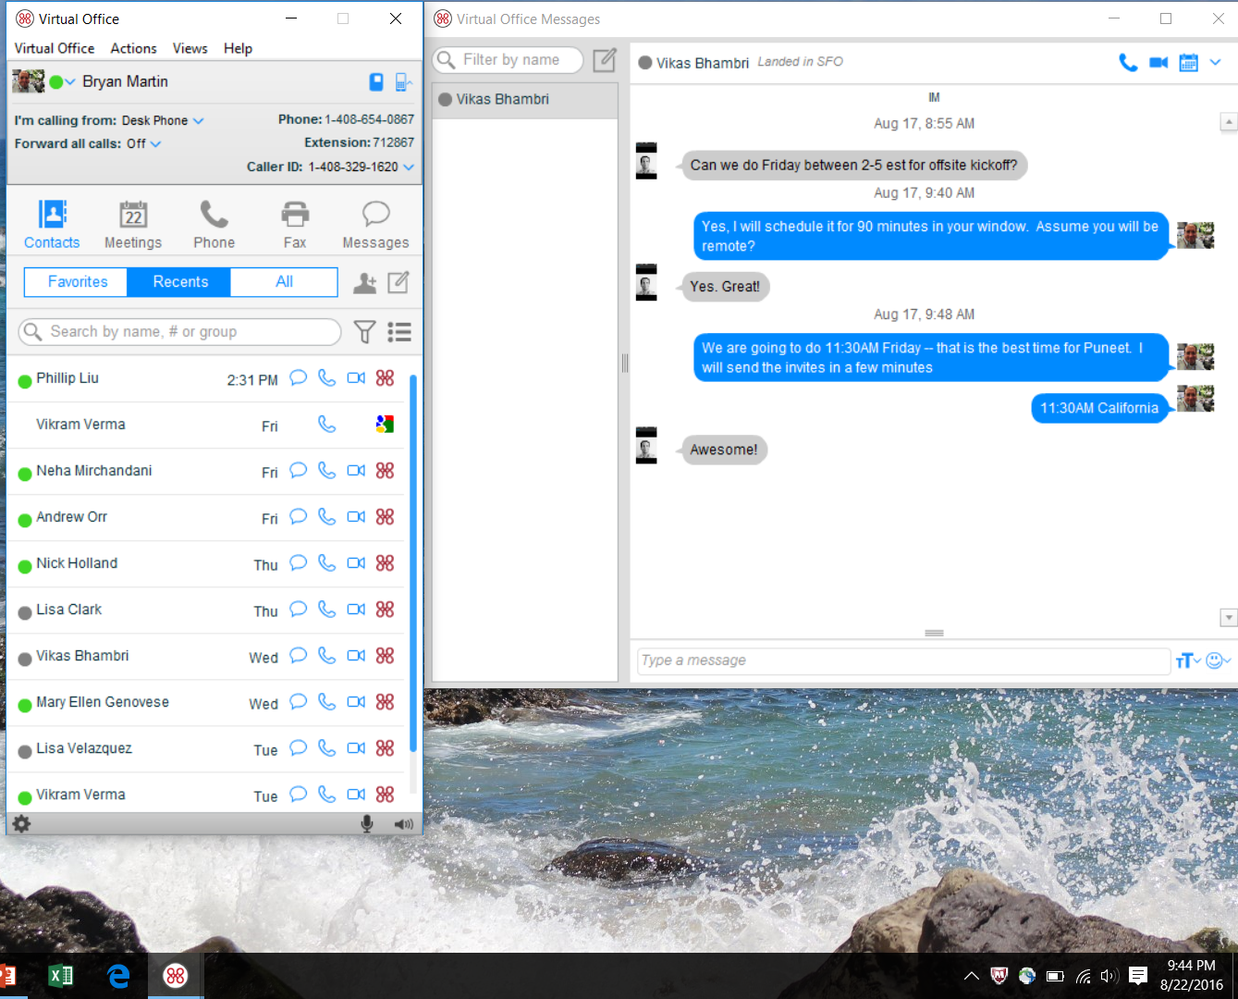
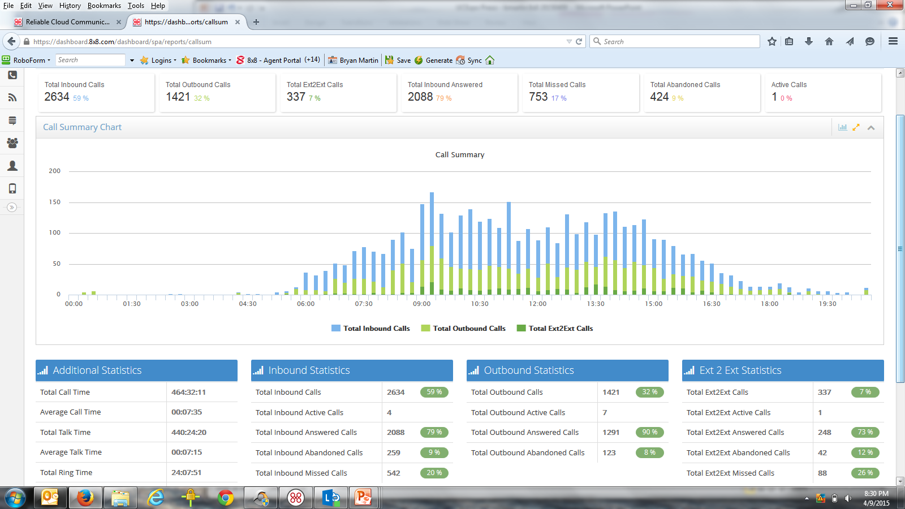

Business Communications: 8x8 Virtual Office
  Cloud Business Phone Service & Unified Communications
  Mobile and desktop applications for all users
  Integration w/leading business apps (Microsoft, NetSuite, Google, Zendesk, Salesforce)
  Presence, IM/Chat, SMS
  Global Directories
  Call Recording
  Data + Media Encryption
CQ1 2017
APIs (Provisioning / Configuration / Data Extraction
AD Automated Provisioning
Enterprise Mgmt Portal

Slide 9
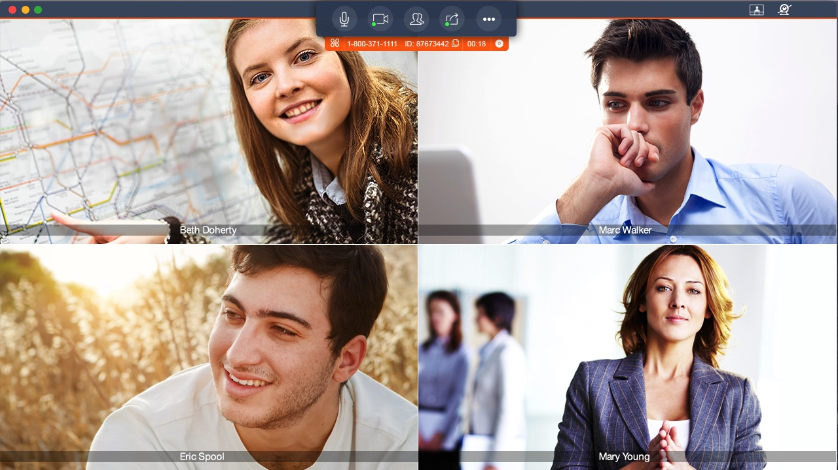
Business Communications: 8x8 Virtual Office Meetings
  Audio/ video/ web conferencing and collaboration with content sharing
  Seamlessly built into Virtual Office mobile and desktop applications
  HD Video (1080p) and HD
  Audio (OPUS)
  Highest resolution with
  lowest latency over public internet and WiFi
  Modular User Interface
  Microsoft Outlook and Google Calendar plug-ins

Slide 10
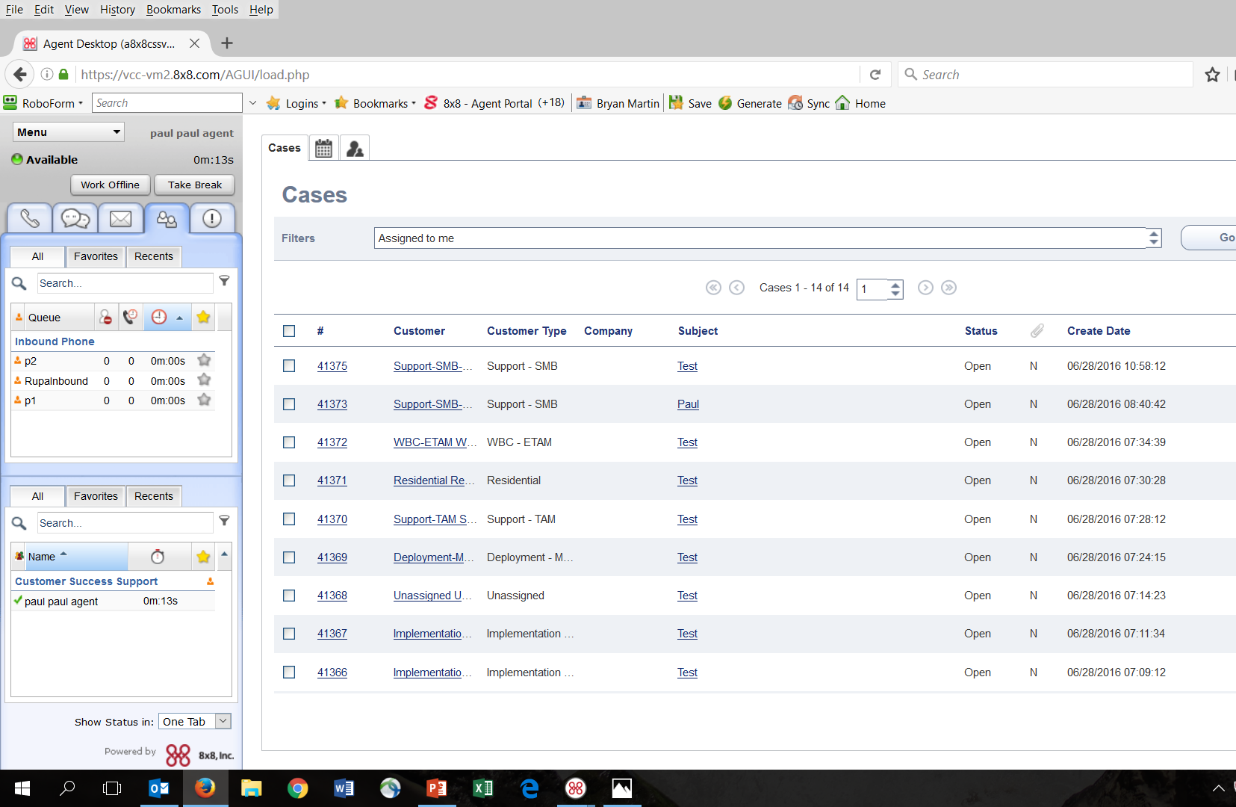

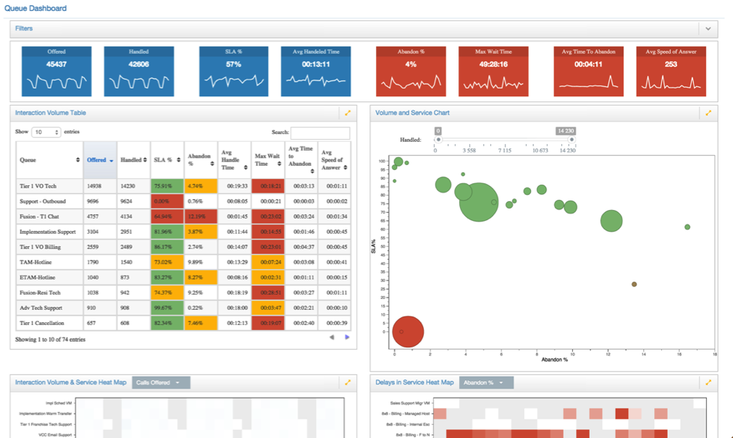
Customer Engagement: 8x8 Virtual Contact Center
  Multi-Channel Cloud Contact Center Solution: Voice, Multi-Chat, Email, Fax
  Multi-media Queuing; Skills-based Routing; Real-time Monitoring and Reporting
  Direct Agent Routing; Proactive Chat
  Workforce and Quality Management
  Single Sign On with Netsuite, Salesforce Integration
  Expert Connect (VO+VCC Interoperability)
  Global Media Routing for 24/7 Follow-the-Sun
  Powerful business performance analytics – Customer Journey; Agent Productivity
CQ1 2017
APIs (Provisioning / Configuration / Data Extraction
AD Automated Provisioning
Enterprise Mgmt Portal

Slide 11
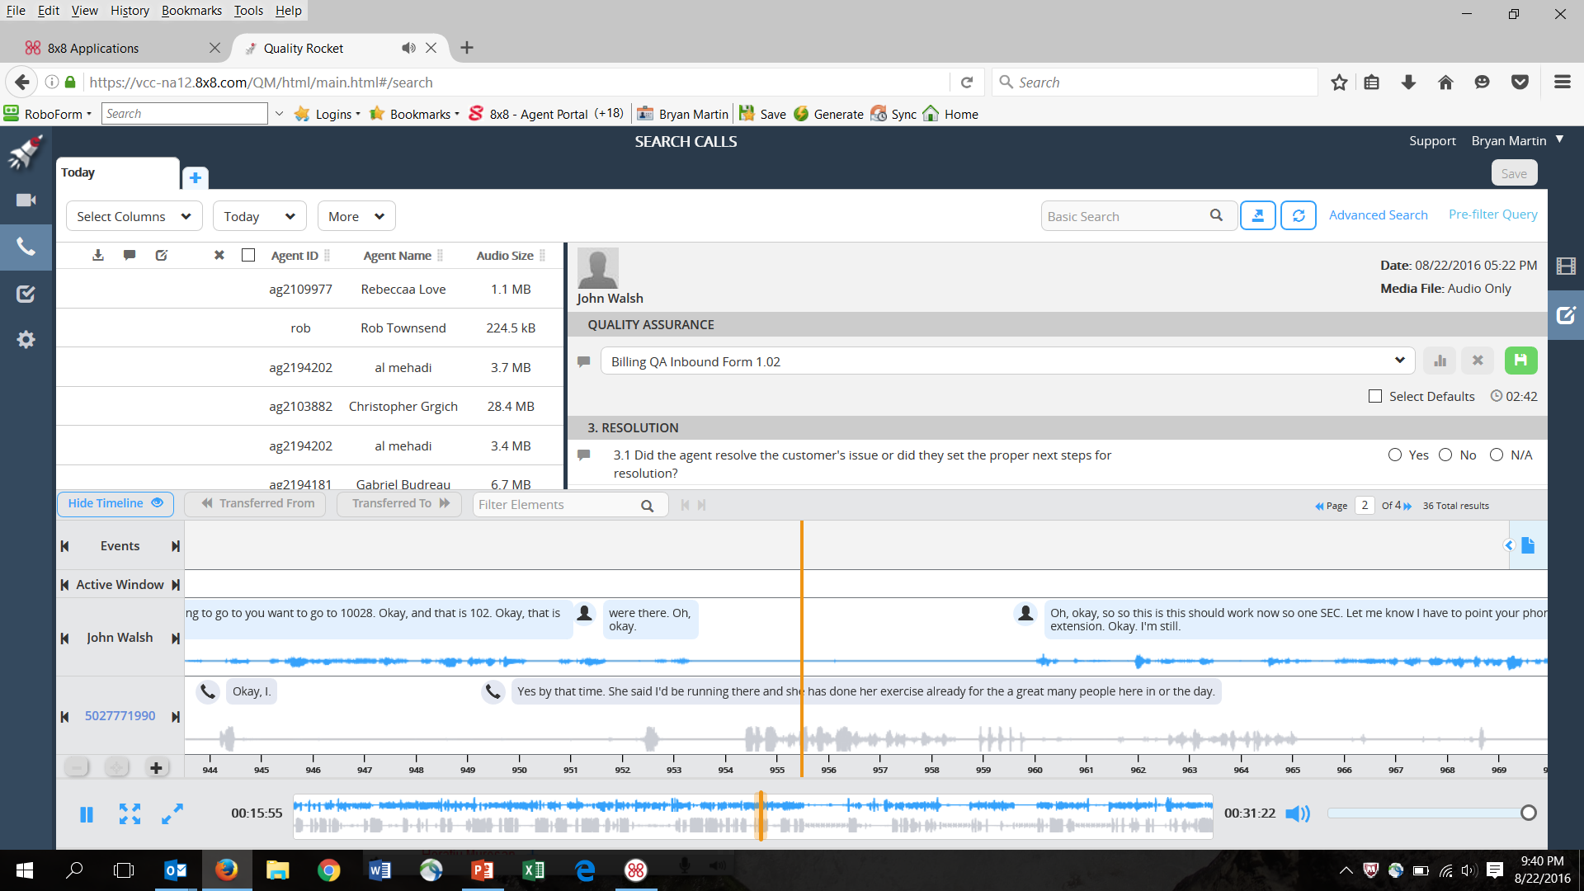
Customer Engagement: 8x8 Quality Management
  Call recording
  & screen capture
  Live monitoring
  Speech transcription
  and analytics
  QA / evaluations and performance analytics
  Scalable for teams
  of all sizes

Slide 12


High Quality Global Communications Network
12 Data Centers Serving Customers in 114 Countries |
Local numbers in 83 countries; toll-free numbers in 122 countries | 7 Global deployment/support teams: US, UK, Europe, Singapore/Asia,
Australia (Philippines and Romania new in 2016)
Patented Geo-Routing technology
for optimized media routing
Global SLA for availability
and call quality
Advanced Routing/ Sophisticated
PSTN/ Vendor Quality Management
Superior audio stack; Advanced audio CODECs/ error correction
Localized branches with global
ext.-to-ext. dialing
Local language support for 14 languages; chat translation in 90 languages
Database of regulatory
requirements in 62 countries
2 - Saskatchewan
Canada
2 - London,
UK (Europe)
Amsterdam,
Netherlands EU
Ashburn, VA
United States
Hong Kong (Asia)
Singapore (Asia)
2 - Santa Clara, CA United States
Rio
Brazil
Sydney,
Australia

Slide 13







Industry-Leading Compliance & Security
Not only within 8x8, but so 8x8 customers
can be compliant
Active and passive monitoring
  Protecting our customers 24x7
  Ensuring optimal service margins
Internally developed technology means adapting to and addressing new situations near real-time
Data retention and recoverable archives

Slide 14




Elite Touch Customer Care
Solutions Engineering
Deploy & Time to Value
Customer Support
Network
Readiness
Remote /
Onsite
Design
System Config.
Training
Go-Live
Self
Help
24/7
Support
Dedicated
CSM
Notes:
Purpose of slide: demonstrate we have a strong support structure, detailed methodology, and that we will be able to take care of prospect through all phases of the process.
---------------------------------
Now there’s a lot of technology we’ve gone over…but we want you to feel comfortable knowing we have detailed methodologies in place and we’ll be a partner with you to ensure you’re successful along each part of the process going forward…
Starting with our pre-sales solution engineers we will run through a full network readiness assessment to help make sure your network is ready for cloud communications, from there…(speak high level about each of the 3 steps, go into additional detail if applicable in specific section).

Slide 15




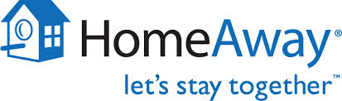






















Customers of All Sizes Choose 8x8
250 to 1,000
EMPLOYEES
1,000 to 5000
EMPLOYEES
5,000+
EMPLOYEES
Branches
15
Notes:
Dyn: VO (383) / VCC (125) - US, UK, Singapore, Australia
Shutterstock: VO (534) / VCC (109) - UK, Asia, Canada and more
Zebra: VO (4907) / VCC (24)
Learn4life: VO (1421) / VCC (4) In over 70 locations
Champion: VO (1345) / VCC (10)
Social Finance: VO (457) / VCC (240)
Regus: VO (14920) We beat Fuze and Interactive Intelligence, We won because of our position in the Gartner Magic Quadrant Leader, we have global presence, VCC Global and Ease of implementation
GameStop: VO (9743) / VCC (105) We beat out AT&T, RNG and Fuz. We won because of Global presence, Full featured integrated CC, Creative retail service package and VO Analytics
HomeAway: VO (2), VCC (613)
Office Depot: VO (14160)
AutoEurope: VO (601)/VCC (305) We beat out Fuze. We won because of we are a Gartner MQ leader, Single vendor with one platform across UC & CC, Global presence, Security & Compliance
Macaroni Grill: VO (703) Currently all locations the US with plans for international
Shutterstock: VO (534) VCC (109)
Mobi: VO (241), VCC (220) We replaced Interactive Intelligence, Overnight deployment
Nutanix VO (23) / VCC (120)
AllState VO (485)

Slide 16
Financials
Third Quarter Fiscal 2017

Slide 17
Q3 FY2017 Financial & Business Highlights
Service revenue grew 23% YoY (25% on constant currency basis) to $60.1M;
total revenue grew 20% YoY (22% on constant currency basis) to $63.7M.
Service revenue from mid-market and enterprise customers grew 36% YoY
(45% on constant currency basis) and now represents 55% of total service revenue.
New MRR sold to mid-market and enterprise customers and by channel sales teams accounted for 60% of total MRR booked in the quarter.
New Master Service Agreement signed with a Fortune 50 health care corporation
to deploy services to approximately 10,000 users in 450 medical offices.
New agreement signed with a 3,500 store national retail chain for over 10,000 seats.
2.0 Global Channel Program and new PartnerConnect Channel Portal launched.
Acquisition of small, innovative technology company in collaboration space
completed in early January 2017.

Slide 18
Strong Revenue Growth; Continued Profitability
Revenue Growth
($ in millions)
Non-GAAP Net Income as % of Total Revenue
($ in millions)

Slide 19
Consistently Low Gross Revenue Churn Rate
Notes:
We report gross revenue churn - that is we do not offset revenue from customer cancellations with new revenue
As you can see, our churn is very low

Slide 20
Strong Balance Sheet
$ in millions

Slide 21
Thank you

